Slide 1

Design & Analysis of Algorithm
CS-503
Computer Science
Lecture 9
Single source shortest path algorithm
BY: Bushra Saif

Slide 2
Single source shortest path (SSSP)
In the Single-Source Shortest Paths (SSSP) problem, we aim to find the shortest paths weights from a particular single-source vertex to all other vertices in a directed weighted graph (if such paths exist).
The SSSP problem has several different efficient (polynomial) algorithms (e.g. Bellman Ford, BFS, DFS, Dijkstra — 2 versions, and/or Dynamic Programming) that can be used depending on the nature of the input directed weighted graph, i.e. weighted/unweighted, with/without (negative weight) cycle, or structurally special (a tree/a DAG).
L1.<number>

Slide 3
Motivation
SSSP is one of the most frequent graph problem encountered in real-life. Every time we want to move from one place (usually our current location) to another (our destination), we will try to pick a short — if not the shortest — path.
SSSP algorithm(s) is embedded inside various map software like Google Maps and in various Global Positioning System (GPS) tool.
L1.<number>

Slide 4
Dijkstra Algorithm
Dijkstra’s algorithm is one of the SSSP (Single Source Shortest Path) algorithms. Therefore, it calculates the shortest path from a source node to all the nodes inside the graph.
Dijkstra’s algorithm solves the single-source shortest-paths problem on a directed weighted graph G = (V, E), where all the edges are non-negative (i.e., w(u, v) ≥ 0 for each edge (u, v) Є E).
In Dijkstra’s algorithm, we start from a source node and initialize its distance by zero. Next, we push the source node to a priority queue with a cost equal to zero.
L1.<number>

Slide 5
Dijkstra Algorithm conditions
It is important to note the following points regarding Dijkstra Algorithm-
Dijkstra algorithm works only for connected graphs.
Dijkstra algorithm works only for those graphs that do not contain any negative weight edge.
The actual Dijkstra algorithm does not output the shortest paths.
It only provides the value or cost of the shortest paths.
By making minor modifications in the actual algorithm, the shortest paths can be easily obtained.
Dijkstra algorithm works for directed as well as undirected graphs.
L1.<number>

Slide 6
Dijkstra problem- Output
The objective of the SSSP problem is to find the shortest path weight from u to v where, if the distance of u and the cost of (u,v) is less than from distance of v then we will update the distance of destination.
  If (d (u)+c(u,v) < d(v))
  then d(v) = d(u)+c(u+v)
  else d(v) remains same
The cost of the shortest path from s to s is trivial: 0.
The cost of the shortest path from s to any unreachable vertex is also trivial: +∞.
L1.<number>

Slide 7
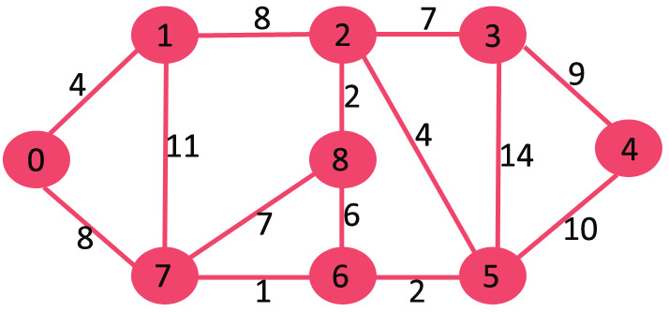
Example – Undirected graph
Let us understand with the following example of undirected graph:
L1.<number>

Slide 8
Example
The set sptSet is initially empty and distances assigned to vertices are {0, INF, INF, INF, INF, INF, INF, INF} where INF indicates infinite ∞. Now pick the vertex with a minimum distance value. The vertex 0 is picked, include it in sptSet. So sptSet becomes {0}. After including 0 to sptSet, update distance values of its adjacent vertices. Adjacent vertices of 0 are 1 and 7. The distance values of 1 and 7 are updated as 4 and 8 from ∞.
1
4
0
7
8
L1.<number>

Slide 9
Example
Pick the vertex with minimum distance value and not already included in SPT (not in sptSET). The vertex 1 is picked and added to sptSet. So sptSet now becomes {0, 1}. Update the distance values of adjacent vertices of 1. The distance value of vertex 2 becomes 12 and the 7 becomes 15. now you have to take decision on the bases of equation which distance you will choose on 7 vertex.
4
12
1
2
0
7
8/15
L1.<number>

Slide 10
Example
Pick the vertex with minimum distance value and not already included in SPT (not in sptSET). Vertex 7 is picked. So sptSet now becomes {0, 1, 7}. Update the distance values of adjacent vertices of 7. The distance value of vertex 5 and 8 becomes finite (9 and 15 respectively).
4
2
1
12
8
15
0
8
9
7
5
L1.<number>

Slide 11
Example
Pick the vertex with minimum distance value and not already included in SPT (not in sptSET). Vertex 5 is picked. So sptSet now becomes {0, 1, 7, 5}. Update the distance values of adjacent vertices of 6 and 8.
4
2
12
1
8
15/15
0
8
11
7
5
6
9
L1.<number>

Slide 12
Example
Pick the vertex with minimum distance value and not already included in SPT (not in sptSET). Vertex 6 is picked. So sptSet now becomes {0, 1, 7, 5, 6}. Update the distance values of adjacent vertices of 6. The distance value of vertex 4 and 3 and 2 are updated to 21, 25 and remain 12.
25
4
2
12/15
3
1
21
15
4
8
0
8
11
7
5
6
9
L1.<number>

Slide 13
Example
Pick the vertex with minimum distance value and not already included in SPT (not in sptSET). Vertex 2 is picked. So sptSet now becomes {0, 1, 7, 5, 6, 2}. Update the distance values of adjacent vertices of 2. The distance value of vertex 8 and 3 are updated.
12
25/19
4
2
3
1
21
8
4
15/14
0
8
7
5
6
9
11
L1.<number>

Slide 14
Example
Pick the vertex with minimum distance value and not already included in SPT (not in sptSET). Vertex 8 is picked. So sptSet now becomes {0, 1, 7, 5, 6, 2, 8}. But from v8, v2, v5, and v7 are already visited so no one will traversed again.
12
19
4
2
3
1
21
8
4
14
0
8
7
5
6
9
11
L1.<number>

Slide 15
Example
Pick the vertex with minimum distance value and not already included in SPT (not in sptSET). Vertex 3 is picked. So sptSet now becomes {0, 1, 7, 5, 6, 2, 8, 3}. And we will check the distance from 3 to adjacent vertex that is only v4 in this case. (update/same)
12
19
4
2
3
1
8
4
14
0
8
21/25
7
5
6
9
11
L1.<number>

Slide 16
Example
Pick the vertex with minimum distance value and not already included in SPT (not in sptSET). Vertex 4 is picked because it’s last choice for us. So sptSet now becomes {0, 1, 7, 5, 6, 2, 8, 3, 4}. And we will check the adjacent vertex but we don’t have any unvisited v now so the algorithm Will end here.
12
19
4
2
3
1
8
4
0
14
8
21
7
5
6
9
11
L1.<number>

Slide 17






























Example
Hence, the minimum distance of vertex 0 from vertex 4 is 21.
12
4
2
19
1
3
21
0
4
8
14
7
6
5
11
8
9

Slide 18
Example – Directed graph
B
1
D
10
A
2
9
3
6
5
C
2
E

Slide 19
Example1
In this graph we have A as a source, for last example we updated the distance manually but for this we will draw a table.
Distance from s to s will be 0 and other will be infinity as we discussed in last example.
Now check which vertex has minimum distance, we will select that vertex. In this example 0 is mini. Distance.
We will check the adjacent vertex/s from A, that are B and C. Apply same formula for this problem too.
  If (d (u)+c(u,v) < d(v))
  then d(v) = d(u)+c(u+v)
  else d(v) remains same
L1.<number>

Slide 20
Example
We will again check the minimum distance of vertex and select this for further calculation.
In this graph we have A as a source, for last example we updated the distance manually but for this we will draw a table.
Selected Vertex | A | B | C | D | E
A | 0 | ∞ | ∞ | ∞ | ∞
C |  | 10 | 5 | ∞ | ∞
E |  | 8 |  | 14 | 7
B |  | 8 |  | 13
 |  |  |  | 9
L1.<number>

Slide 21
Example – path calculation
Now if we want to check the shortest path from a source to specific vertex, may be we don’t have direct path. But we want to check short distance and also that path.
Suppose we want to see the shortest path of D from A.
  We will point on final distance of that vertex in table
  Then go on one step back, if distance is changed see who bring change and jump on that distance
  Then again go one step back and apply same condition
  Repeat the same steps, until you reach on source vertex.
  But if the distance is same no need to collect that vertex.
  In above case from vertex A-D apply same steps, the path will be
  D-B-C-A (d, 9)
  What is the shortest path to reach on B? although we know distance.
L1.<number>

Slide 22
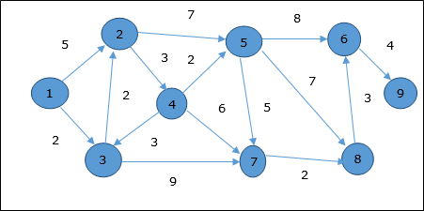
Example 2
Solve this example by yourself, draw a table to update distances and find the shortest path to reach at vertex 7.
L1.<number>

Slide 23
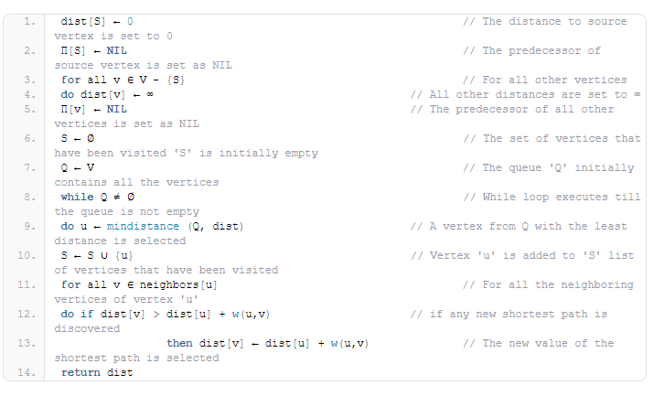
Dijkstra Algorithm SSP
L1.<number>

Slide 24
Dijkstra Algorithm summary
Step-01:
In the first step. two sets are defined-
  One set contains all those vertices which have been included in the shortest path tree.
  In the beginning, this set is empty.
  Other set contains all those vertices which are still left to be included in the shortest path tree.
  In the beginning, this set contains all the vertices of the given graph.
L1.<number>

Slide 25
Dijkstra Algorithm summary
Step-02:
For each vertex of the given graph, two variables are defined as-
  Π[v] which denotes the predecessor of vertex ‘v’
  d[v] which denotes the shortest path estimate of vertex ‘v’ from the source vertex.
  Initially, the value of these variables is set as-
  The value of variable ‘Π’ for each vertex is set to NIL i.e. Π[v] = NIL
  The value of variable ‘d’ for source vertex is set to 0 i.e. d[S] = 0
  The value of variable ‘d’ for remaining vertices is set to ∞ i.e. d[v] = ∞
L1.<number>

Slide 26
Dijkstra Algorithm summary
Step-03:
The following procedure is repeated until all the vertices of the graph are processed-
  Among unprocessed vertices, a vertex with minimum value of variable ‘d’ is chosen.
  Its outgoing edges are relaxed.
  After relaxing the edges for that vertex, the sets created in step-01 are updated.
L1.<number>

Slide 27
Dijkstra Algorithm Analysis
The complexity of this algorithm is fully dependent on the implementation of Extract-Min function. If extract min function is implemented using linear search, the complexity of this algorithm is O(V² + E) and O(E+VlogV) using Fibonacci heap.
In this algorithm, if we use min-heap on which Extract-Min() function works to return the node from Q with the smallest key, the complexity of this algorithm can be reduced further.
L1.<number>

Slide 28
Limitation
So, we proved the optimality of Dijkstra’s algorithm. However, to do this, we assumed that all the edges have non-negative weights. Therefore, Path(u, v) will always be non-negative as well.
When working with graphs that have negative weights, Dijkstra’s algorithm fails to calculate the shortest paths correctly. The reason is that Path(u, v) might be negative, which will make it possible to reach u from v at a lower cost. Therefore, we can’t prove the optimality of choosing the node that has the lowest cost.
L1.<number>

Slide 29
Limitation proof
Here 1 is a source vertex, so distance of 1 is 0, and other is infinity. Select 1, and update v2 and v3 distance from ∞. Next minimum distance is on v2 but we can’t update any d(v). Now select v3 according to conditions.
0
5
1
5
2
10
-10
3
4
1
10
11
L1.<number>

Slide 30
Bellman-ford algorithm
As with Dijkstra’s algorithm, the Bellman-Ford algorithm is one of the SSSP algorithms. Therefore, it calculates the shortest path from a starting source node to all the nodes inside a weighted graph. However, the concept behind the Bellman-Ford algorithm is different from Dijkstra’s.
Given a graph and a source vertex src in graph, find shortest paths from src to all vertices in the given graph. The graph may contain negative weight edges.
Bellman-Ford is also simpler than Dijkstra and suites well for distributed systems. But time complexity of Bellman-Ford is O(VE), which is more than Dijkstra.
L1.<number>

Slide 31
Bellman-ford algorithm rule
In the Bellman-Ford algorithm, we begin by initializing all the distances of all nodes with ∞, except for the source node, which is initialized with zero.
In each step, we iterate over all the edges inside the graph. For each edge from node u to v, we update the respective distances of v if needed. The new possible distance equals to the distance of u plus the weight of the edge between u and v.
After V - 1 steps, all the nodes will have the correct distance, and we stop the algorithm, here V is total no. of vertex.
L1.<number>

Slide 32
Example 1
The below example has negative cost also, and it has total 6 vertex. So according to the rule the problem will give optimal answer after 5 iterations. Write the possible edges in G.
(A, B), (A, C), (A, D), (D, C), (C, B), (B, E), (C, E), (E, F), (D, F)
B
-1
6
E
-2
A
4
3
C
3
5
-2
F
-1
D
L1.<number>

Slide 33
Example 1
Iteration 1:
In first iteration calculate the d(v) of every pair from list with the same formula we used in dijkstra algorithm. Rule will be same, take source vertex 0 and other ∞. And update the d(v) according to that equation. After 1st pass d(v) of all vertex is given below,
(A, B), (A, C), (A, D), (D, C), (C, B), (B, E), (C, E), (E, F), (D, F)
(6), (4), (5), (3), (1)
L1.<number>

